Slide 1
Dictionaries and Hashing CSE645 (PG) (Advanced Data Structures MODULE I)

Slide 2
Topics Covered:
Dictionaries
Dictionary Abstract Data Type
Implementation of Dictionaries
Hashing
Review of Hashing
Hash Function
Collision Resolution Techniques in Hashing:
Separate Chaining, Open Addressing, Linear Probing, Quadratic Probing, Double Hashing, Rehashing, Extendible Hashing

Slide 3
Dictionaries Basics CSE645 (PG) (Advanced Data Structures MODULE I)

Slide 4
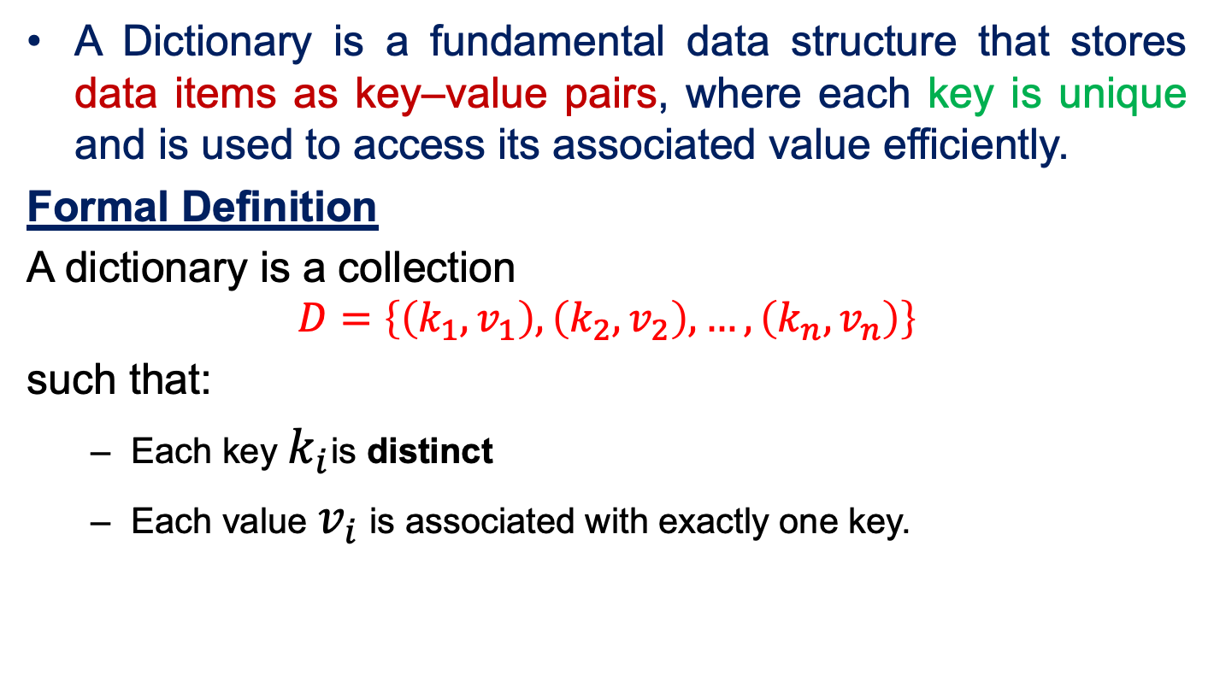
Dictionary: Definition
A Dictionary is a fundamental data structure that stores data items as key–value pairs, where each key is unique and is used to access its associated value efficiently.
Formal Definition
A dictionary is a collection
$$D=\left\{\left(k_{1}​,v_{1}​\right),\left(k_{2}​,v_{2}​\right),…,\left(k_{n}​,v_{n}​\right)\right\}$$
such that:
Each key $k_{i}$is distinct
Each value $v_{i}$ is associated with exactly one key.

Slide 5
Significance of Dictionary
Characteristics:
Supports fast search, insertion, and deletion
Keys can be of various types (integers, strings, objects)
Values can be simple or complex data types
Key Advantages:
1. Fast Data Retrieval
Dictionaries allow direct access using keys
Avoids scanning entire data collections
2. Better Performance Than Linear Structures
Structure | Search Time
Array/List | O(n)
Dictionary | O(1) or O(log n)

Slide 6
Dictionary: Real World Examples
1. Symbol Table in Compilers (Key → Value)
Key: Variable / Function name
Value: Data type, scope, memory address, attributes
2. Database Indexing (Key → Value)
Key: Primary key or indexed column
Value: Pointer to the record location
3. Phone Directory / Contact List (Key → Value)
Key: Person’s name
Value: Phone number(s), address
4. E-commerce Product Lookup (Key → Value)
Key: Product ID
Value: Price, stock, description

Slide 7
Dictionary: Abstract Data Type
An Abstract Data Type (ADT) is a logical or mathematical model of a data structure that defines what operations can be performed on the data, without specifying how those operations are implemented.
Formal Definition
An Abstract Data Type is defined by:
Data objects (values it can store)
Operations that can be performed on those data objects
Rules/ behavior of those operations
Implementation details are hidden.

Slide 8
Dictionary: Abstract Data Type
The Dictionary ADT specifies what operations are supported by the dictionary without defining how they are implemented.
Core Operations:
insert(k, v) | Inserts a key–value pair into the dictionary
delete(k) | Removes the entry with key k
search(k) | Returns the value associated with key k
update(k, v) | Updates the value for an existing key
contains(k) | Checks whether key k exists
size() | Returns number of entries
isEmpty() | Checks if dictionary is empty

Slide 9
Implementation of Dictionary
The abstract nature of the dictionary means it can be implemented using various concrete data structures, each offering different performance trade-offs in terms of time complexity:
1. Hash Table: The most common implementation, offering average constant time (O(1)) for insert, find, and delete operations.
2. Search Tree (e.g., Binary Search Tree (BST)): Provides logarithmic time complexity (O(log n)) for operations and maintains order among the keys.
3. Unsorted List/Array: Operations require linear time (O(n)) in the worst case because a sequential search is needed.
4. Sorted Array: Allows faster searching using binary search (O(log n)), but insertion and removal are slower (O(n)) due to the need to shift elements.

Slide 10
Dictionary: Array Implementation
Key–value pairs stored in an array (ArrayList in Java).
Search, Insert and Delete requires O(n) time complexity (worst case).
Click here for code…

Slide 11
Dictionary: Hash Table Implementation (Most common)
Uses hashing for constant-time access.
Click here for code…
Operation | Average Case | Worst Case
Insert | O(1) | O(n)
Search | O(1) | O(n)
Delete | O(1) | O(n)
HashMap uses a hash function to compute an index.
In the average case, keys are well distributed → constant time.
In the worst case (many hash collisions), all keys fall into the same bucket → linear search.

Slide 12
Dictionary: BST Implementation
In Binary Search Tree (BST), keys are stored in sorted order → ordered dictionary.
In a Binary Search Tree, insert, search, and delete operations take O(h) time, where h is the height of the tree.
Insert Search
Click here for code…
Case | Time
Best | O(1) (insert at root)
Average | O(log n) (balanced BST)
Worst | O(n) (skewed BST)
Case | Time
Best | O(1) (key at root)
Average | O(log n)
Worst | O(n)

Slide 13
Hashing Basics CSE645 (PG) (Advanced Data Structures MODULE I)

Slide 14
Need of Hashing
In data structure, we have mainly two searching techniques: linear search and binary search.
The worst time complexity in linear search is O(n) and O(log n) in binary search.
In both the above searching techniques, the searching depends upon the number of elements (N), but we want the technique that takes a constant time, independent of N.
Hashing is one of the searching techniques that uses a constant time. The time complexity in hashing is O(1).

Slide 15
Hashing Vs Other Search
Drawback of Other Searching Techniques:
As the number of elements increases (N), time taken to perform the search also increases.
This becomes problematic when total number of elements become too large.
Advantage of Hashing:
Unlike other searching techniques, Hashing is extremely efficient.
The time taken by it to perform the search does not depend upon the total number of elements.
Time Complexity is constant, i.e., O(1).

Slide 16
Hashing
Hashing is a well-known search technique to search an element among several elements with constant time complexity.
In Hashing technique, the hash table and hash function are used.
Using the hash function, we can calculate the address at which the value can be stored.
Hash table is an array data structure which is used to store the data items.

Slide 17
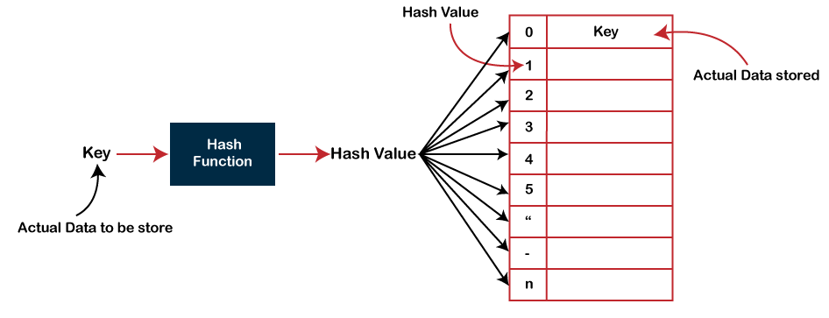
Hashing Mechanism

Slide 18
Types of Hash Function
Hash function takes the data item as an input and returns a small integer value as an output.
The small integer value is called as a hash value. Hash value of the data item is then used as an index for storing it into the hash table.
There are many hash functions that use numeric or alphanumeric keys. Mainly 3 main hash functions are:
Division method
Mid-square method
Folding method

Slide 19

Types of Hash Function
Division method
In the division method, the hash function can be defined as:
$$H(k) = k mod m$$
Where $k$ is the key, $m$is the size of hash table (usually a prime number), and $mod$ is modulo operator(%).
Example: if a hash table has 11 entries (size m), and we want to store key k = 25, then
H(25) = 25 mod 11 = 3
So, key 25 will be stored at index 3 in the hash table.

Slide 20

Types of Hash Function
Mid-Square method
Mid-square method involves 2 steps to compute the hash value:
Square the value of the key $k$ i.e. $k^{2}$
Extract the middle $r$ digits as the hash value
Formula:
$$H\left(k\right)=extract middle r digits from (k × k)$$ where, $k$ is the key value. The value of $r$ can be decided based on the size of the table.

Slide 21

Types of Hash Function
Mid-Square method
Example:
Suppose the hash table has 100 memory locations. So, r = 2 because two digits are required to map the key to the memory location.
Suppose $k =40$, then
The hash value obtained is 60, so store 40 at index 60.

Slide 22

Types of Hash Function
Folding method
The folding method involves 3 steps:
Divide the key ($k$) into equal parts
Sum the parts
Take the modulo with respect to $m$
Formula:
Let key $k$is divided into$n$equal parts, $k_{1}, k_{2}, …, k_{n}$. Then
$$h\left(k\right)=\left(k_{1}+k_{2}+…+k_{n}\right) mod m$$
Where $m$ is size of hash table.

Slide 23

Types of Hash Function
Folding method
Example:
K=123456789, m = 10
Then we can divide key into 2 or 3 or 4 equal parts. Let’s divide the key into 3 equal parts $k_{1}=123, k_{2}=456, k_{3}=789$
Then, $H\left(123456789\right)=\left(123+456+789\right) mod 10$
$$=\left(1368\right) mod 10=8$$
Hence, 123456789 is inserted into the hash table at address 8.

Slide 24

Collision in Hashing
In hashing, Hash function may return the same hash value for two or more keys.
For Example: Let us suppose Division method of hashing.
Hash function is: $H(k) = k mod m$ and size m = 10
Then for keys k = 1,11, 21, 31, …, it always return 1.
When the hash value of a key maps to an already occupied bucket of the hash table, it is called as a Collision.

Slide 25
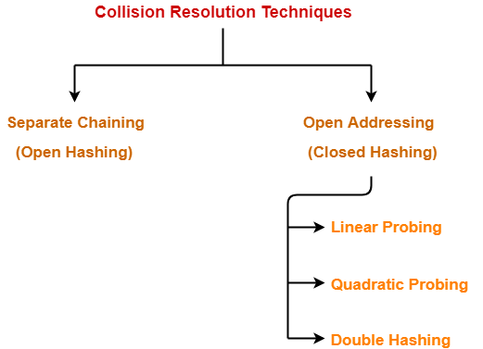
How to Resolve Collision?
Collision Resolution Techniques are the techniques used for resolving or handling the collision.

Slide 26
Thank you.
Any Question?

